Slide 1
Mechanism and Effect Size in Human-Microbiome Association Studies
Anthony Fodor
Bioinformatics and Genomics
UNC Charlotte

Slide 2
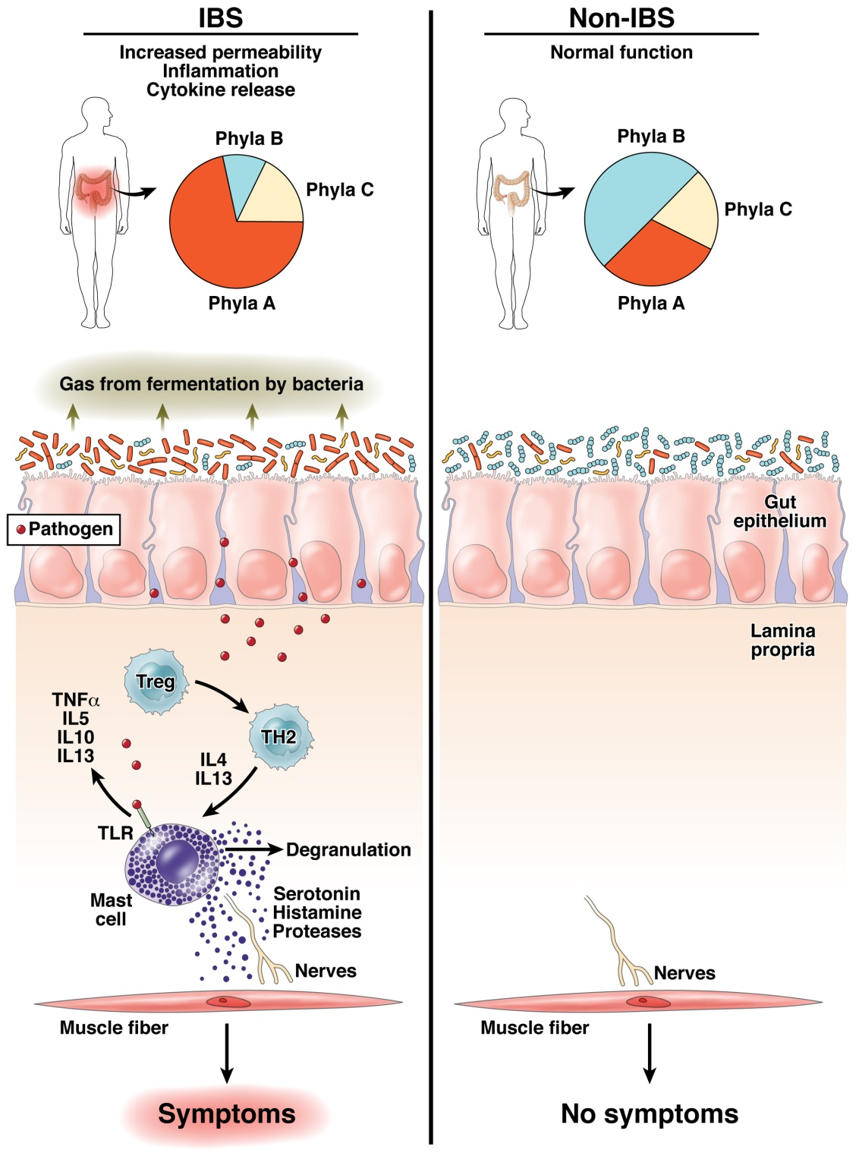
The “dysbiosis” hypothesis linking risk for inflammation related diseases to the microbiome
Fodor & Talley. Gastroenterology. 2011

Slide 3
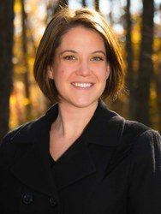

Some microbes, but not others, can cause inflammation to progress to cancer…
IL10 is an anti-inflammatory
cytokine
Gnotobiotic IL10-/- mice
Mono-associated with
E. Coli or E. faecalis
Exposed to carcinogen AOM
Janelle Arthur, UNC
Christian Jobin, UFL
Arthur et al, Science, 2012

Slide 4
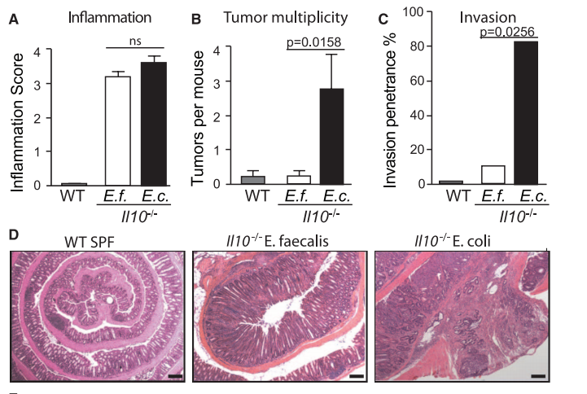
Some microbes, but not others, can cause inflammation to progress to cancer…
IL10 is an anti-inflammatory
cytokine
Gnotobiotic IL10-/- mice
Mono-associated with
E. Coli or E. faecalis
Exposed to carcinogen AOM
Janelle Arthur, UNC
Christian Jobin, UFL
Arthur et al, Science, 2012

Slide 5
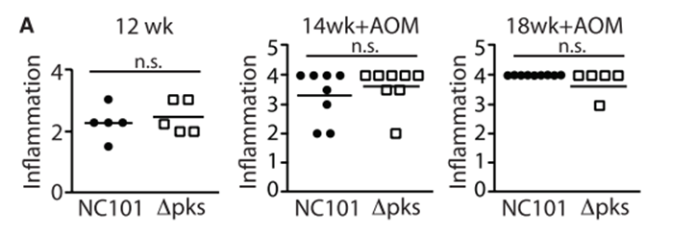
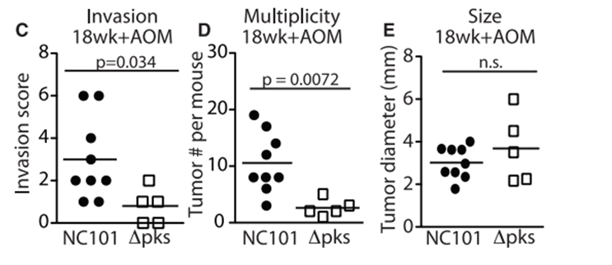
Remarkably, the PKS island appears essential in promoting progress to CRC

Slide 6
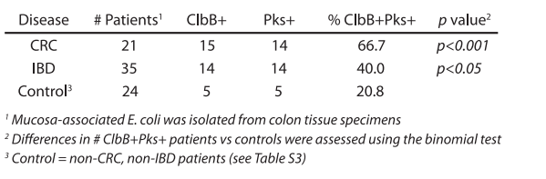
The presence of PKS is associated with cancers in multiple human cohorts

Slide 7
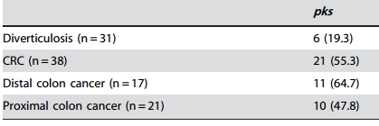
The presence of PKS is associated with cancers in multiple human cohorts
Buc et al - High Prevalence of Mucosa-Associated E. coli Producing
Cyclomodulin and Genotoxin in Colon Cancer (2013)

Slide 8
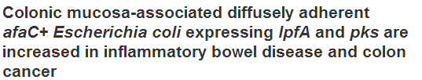
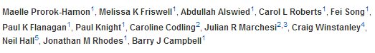
The presence of PKS is associated with cancers in multiple human cohorts
Buc et al - High Prevalence of Mucosa-Associated E. coli Producing
Cyclomodulin and Genotoxin in Colon Cancer (2013)

Slide 9
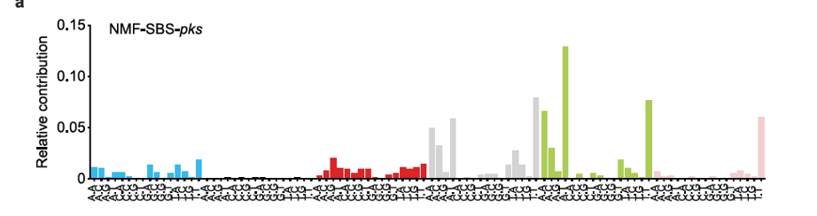

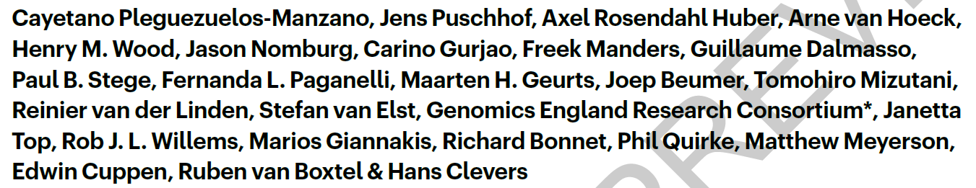
We have increasing detail on the chain of causality
Interferes with
selection against
Inflammation
E. coli/pks
The damage pks-E. Coli
does to DNA can be
directly measured and
quantified
“Invade” the gut
during stress/birth
Stresses host cells
Proteobacteria in
the external enviroment
Cancer
Approximately 5% of all CRCs have a mutational spectrum signature
consistent with E. Coli/pks damage

Slide 10
It is not always straight-forward to elucidate mechanism

Slide 11
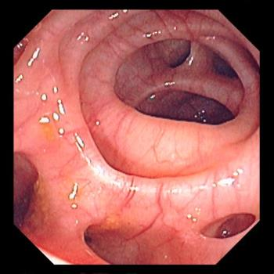

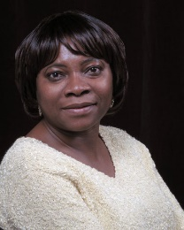
Roshonda Barner Jones
University of Southern California
Biopsies from 226 case and 309 control obtained via
colonoscopy
Temitope Keku
UNC Chapel Hill
Image: https://www.merckmanuals.com/-/media/manual/professional/images/diverticulosis_high.jpg?la=en&thn=0&mw=350
An Aberrant Microbiota is not Strongly Associated with Incidental Colonic Diverticulosis Roshonda B. Jones, Anthony A. Fodor, Anne F. Peery, Matthew C. B. Tsilimigras, Kathryn Winglee, Amber McCoy,Michael Sioda ,Robert S. Sandler, Temitope O. Keku. Scientific Reports. 2018.
Notes:
A colonic diverticulum is a saclike pouch of colonic mucosa and submucosa that protrudes through the muscular layer of the colon

Slide 12
Roshonda Barner Jones
University of Southern California
Biopsies from 226 case and 309 control obtained via
colonoscopy
Temitope Keku
UNC Chapel Hill
Microbial DNA extracted – PCR targeting the 16S rRNA gene
Image: https://www.merckmanuals.com/-/media/manual/professional/images/diverticulosis_high.jpg?la=en&thn=0&mw=350
An Aberrant Microbiota is not Strongly Associated with Incidental Colonic Diverticulosis Roshonda B. Jones, Anthony A. Fodor, Anne F. Peery, Matthew C. B. Tsilimigras, Kathryn Winglee, Amber McCoy,Michael Sioda ,Robert S. Sandler, Temitope O. Keku. Scientific Reports. 2018.
Notes:
A colonic diverticulum is a saclike pouch of colonic mucosa and submucosa that protrudes through the muscular layer of the colon

Slide 13
Roshonda Barner Jones
University of Southern California
Biopsies from 226 case and 309 control obtained via
colonoscopy
Temitope Keku
UNC Chapel Hill
Microbial DNA extracted – PCR targeting the 16S rRNA gene
Sequences generated via Illumina sequencing.
Classified into a counts table
Image: https://www.merckmanuals.com/-/media/manual/professional/images/diverticulosis_high.jpg?la=en&thn=0&mw=350
An Aberrant Microbiota is not Strongly Associated with Incidental Colonic Diverticulosis Roshonda B. Jones, Anthony A. Fodor, Anne F. Peery, Matthew C. B. Tsilimigras, Kathryn Winglee, Amber McCoy,Michael Sioda ,Robert S. Sandler, Temitope O. Keku. Scientific Reports. 2018.
Notes:
A colonic diverticulum is a saclike pouch of colonic mucosa and submucosa that protrudes through the muscular layer of the colon

Slide 14
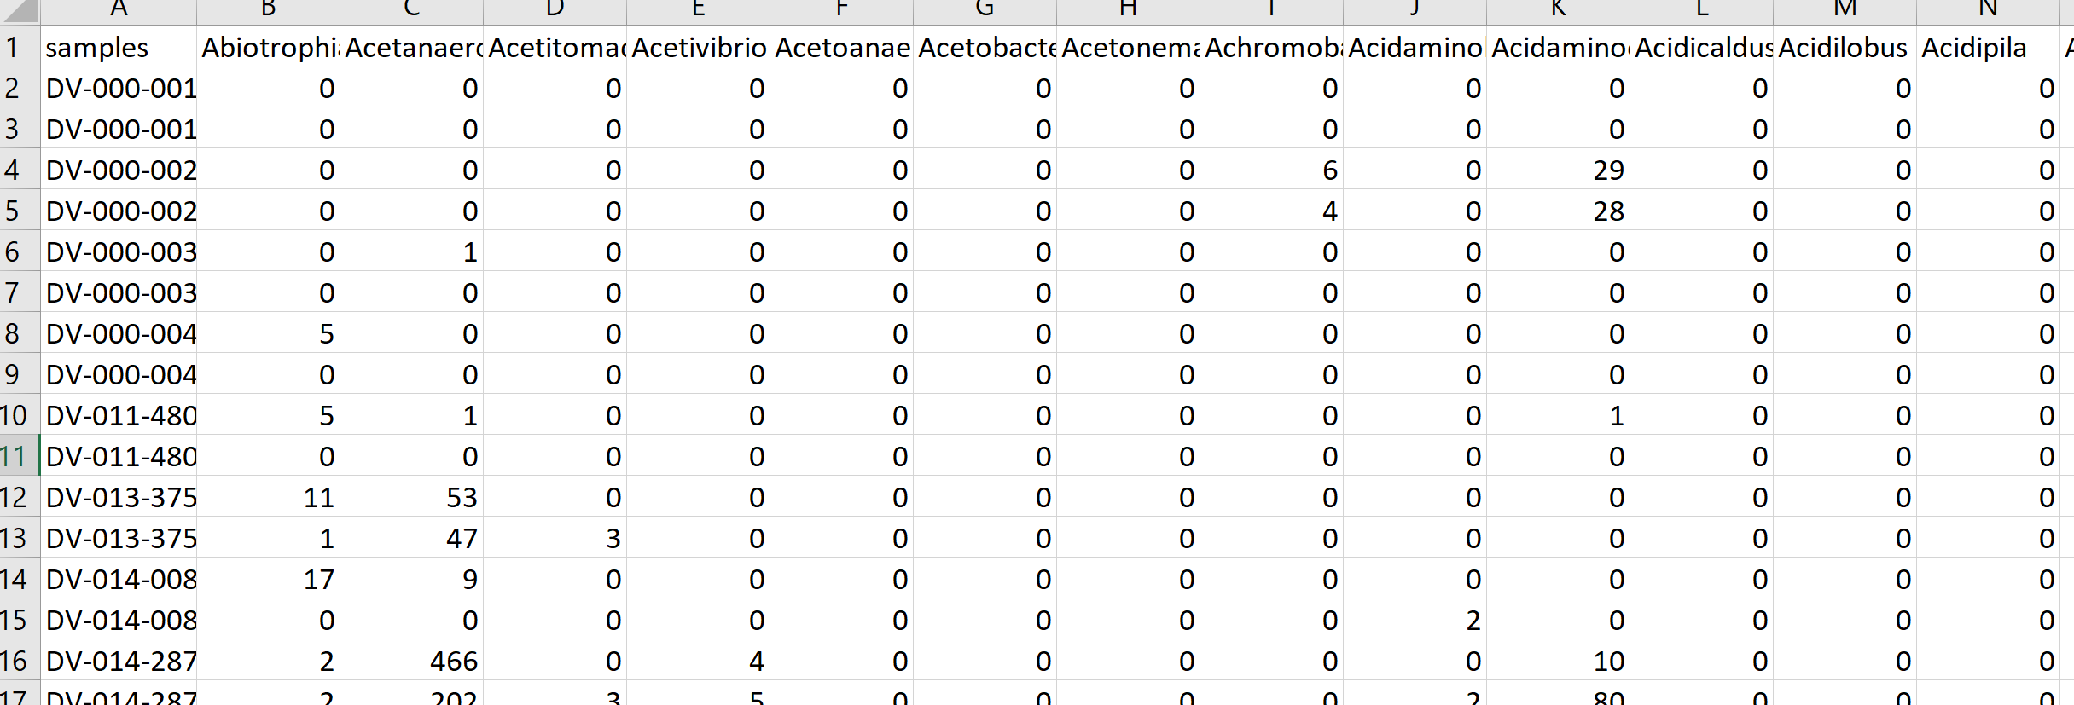
Roshonda Barner Jones
University of Southern California
Biopsies from 226 case and 309 control obtained via
colonoscopy
Temitope Keku
UNC Chapel Hill
Microbial DNA extracted – PCR targeting the 16S rRNA gene
Sequences generated via Illumina sequencing.
Classified into a counts table
Image: https://www.merckmanuals.com/-/media/manual/professional/images/diverticulosis_high.jpg?la=en&thn=0&mw=350
An Aberrant Microbiota is not Strongly Associated with Incidental Colonic Diverticulosis Roshonda B. Jones, Anthony A. Fodor, Anne F. Peery, Matthew C. B. Tsilimigras, Kathryn Winglee, Amber McCoy,Michael Sioda ,Robert S. Sandler, Temitope O. Keku. Scientific Reports. 2018.
Notes:
A colonic diverticulum is a saclike pouch of colonic mucosa and submucosa that protrudes through the muscular layer of the colon

Slide 15
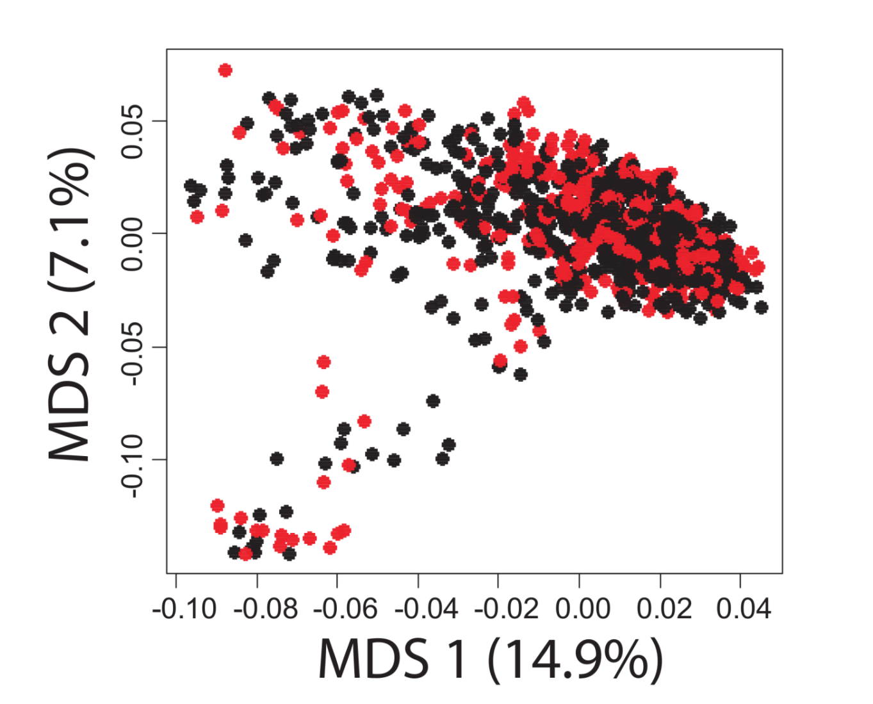
A case-control study in Colonic Diverticulosis with a small effect size
Roshonda Barner Jones
University of Southern California
Temitope Keku
UNC Chapel Hill
An Aberrant Microbiota is not Strongly Associated with Incidental Colonic Diverticulosis Roshonda B. Jones, Anthony A. Fodor, Anne F. Peery, Matthew C. B. Tsilimigras, Kathryn Winglee, Amber McCoy,Michael Sioda ,Robert S. Sandler, Temitope O. Keku. Scientific Reports. 2018.

Slide 16
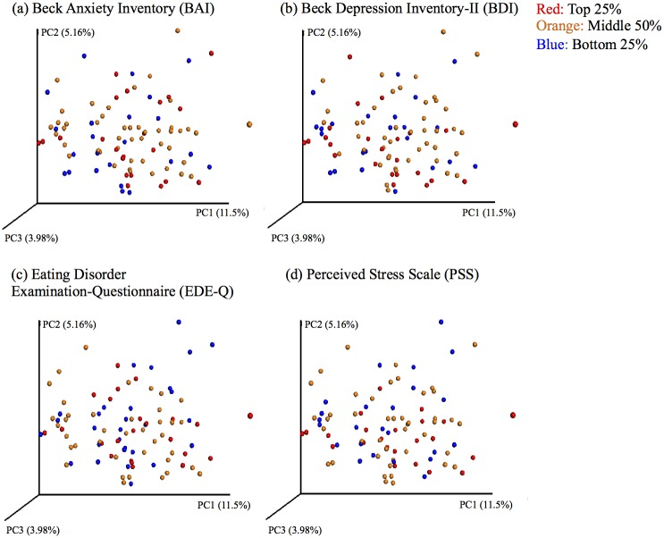

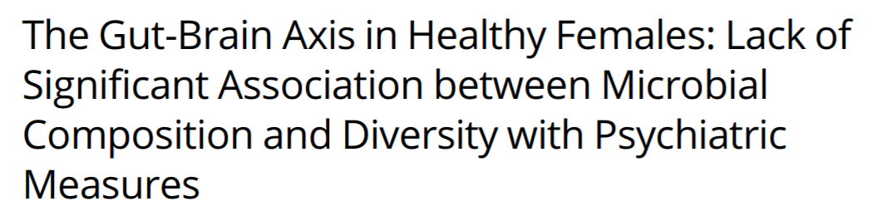
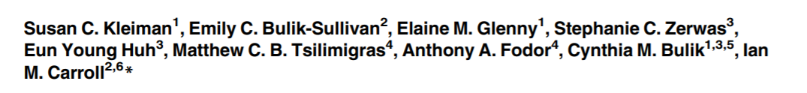
Ian Carroll
UNC Chapel Hill

Slide 17
Effect Sizes in Association Studies are Reliably Small
There is strong individual variation in the microbiome

Slide 18
Effect Sizes in Association Studies are Reliably Small
There is strong individual variation in the microbiome
Sample sizes need to be very large

Slide 19

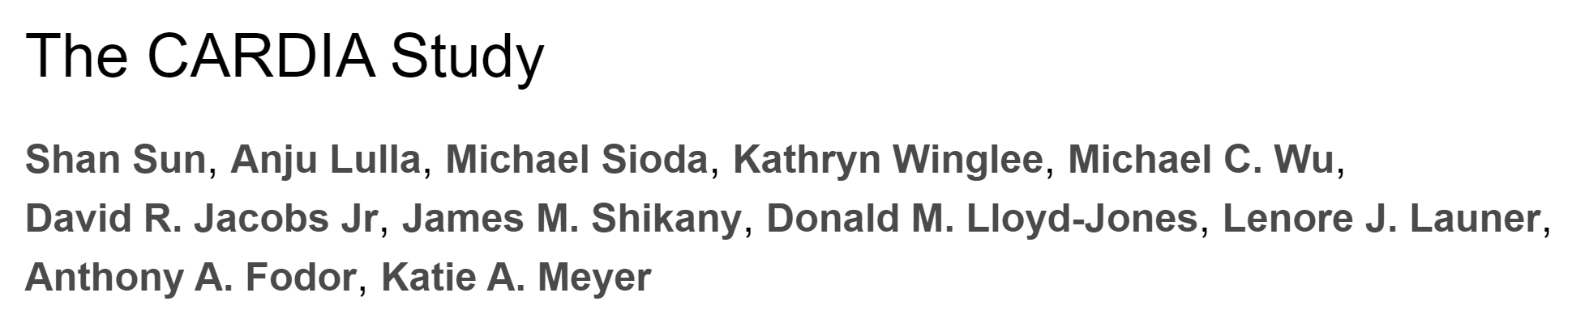
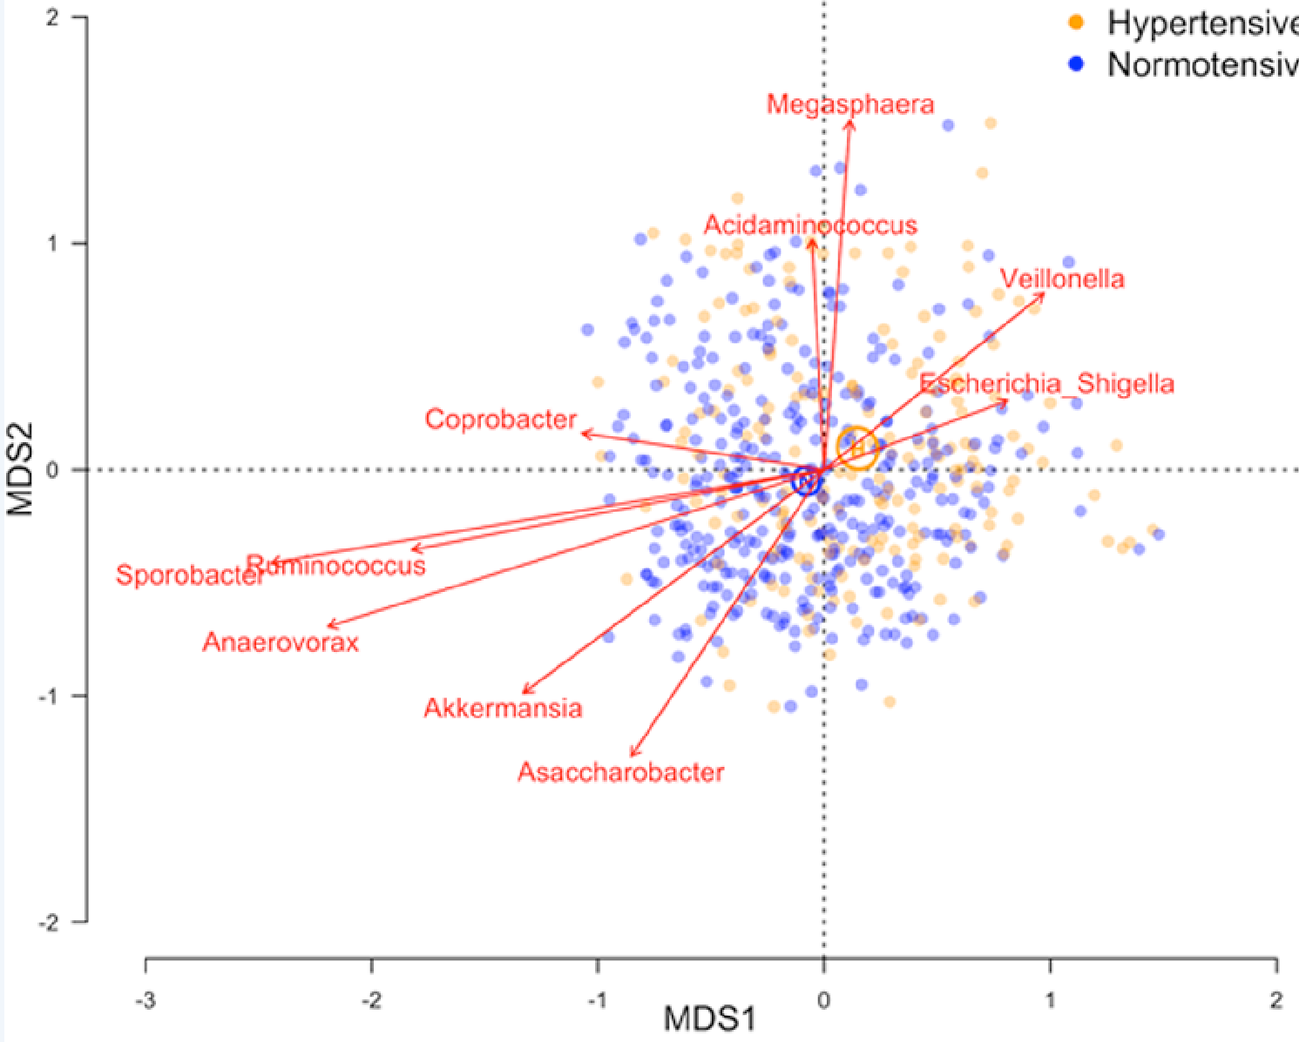

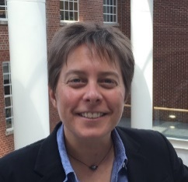
Shan Sun
UNC Charlotte
Katie Meyer UNC
N=529

Slide 20
Effect Sizes in Association Studies are Reliably Small
There is strong individual variation in the microbiome
The microbiome is an environmental variable
and important interactions with the host are
not globally conserved

Slide 21
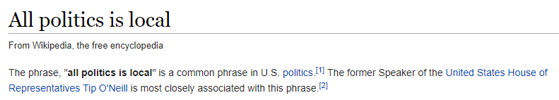
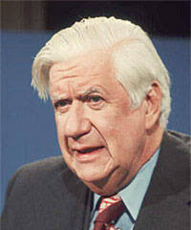

Slide 22

The microbiome is an environmental variable that is sensitive to local conditions
Penny Gordon-
Larsen
UNC Chapel Hill
Shan Sun
UNC Charlotte
(in press, BMC Open)

Slide 23
The microbiome is an environmental variable that is sensitive to local conditions
2,164 subjects from the China Health and Nutrition Survey
(http://www.cpc.unc.edu/projects/china )
Penny Gordon-
Larsen
UNC Chapel Hill
Shan Sun
UNC Charlotte
(in press, BMC Open)

Slide 24
The microbiome is an environmental variable that is sensitive to local conditions
2,164 subjects from the China Health and Nutrition Survey
(http://www.cpc.unc.edu/projects/china )
Fecal samples collected; 16S rRNA sequencing
Penny Gordon-
Larsen
UNC Chapel Hill
Shan Sun
UNC Charlotte
(in press, BMC Open)

Slide 25
The microbiome is an environmental variable that is sensitive to local conditions
2,164 subjects from the China Health and Nutrition Survey
(http://www.cpc.unc.edu/projects/china )
Fecal samples collected; 16S rRNA sequencing
Classification and generation of count table
Penny Gordon-
Larsen
UNC Chapel Hill
Shan Sun
UNC Charlotte
(in press, BMC Open)

Slide 26
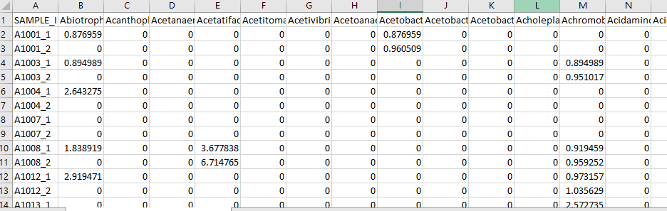
The microbiome is an environmental variable that is sensitive to local conditions
2,164 subjects from the China Health and Nutrition Survey
(http://www.cpc.unc.edu/projects/china )
Fecal samples collected; 16S rRNA sequencing
Classification and generation of count table
Penny Gordon-
Larsen
UNC Chapel Hill
Shan Sun
UNC Charlotte
(in press, BMC Open)

Slide 27
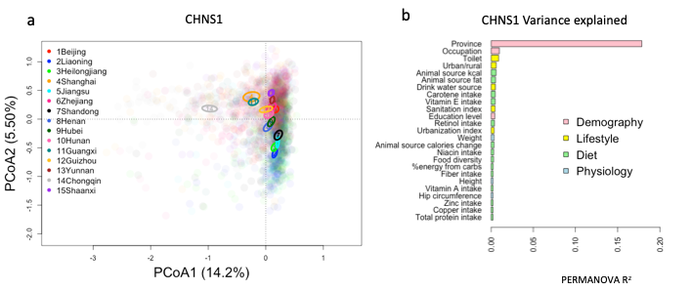
The microbiome is an environmental variable that is sensitive to local conditions
CHINA
Penny Gordon-
Larsen
UNC Chapel Hill
Shan Sun
UNC Charlotte
(in press, BMC Open)

Slide 28
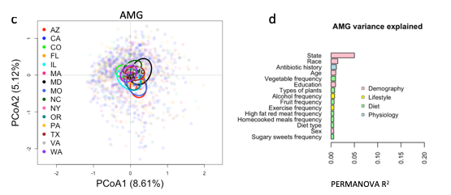
The microbiome is an environmental variable that is sensitive to local conditions
CHINA
Penny Gordon-
Larsen
UNC Chapel Hill
US
(American Gut)
Shan Sun
UNC Charlotte
(in press, BMC Open)

Slide 29
The microbiome is an environmental variable that is sensitive to local conditions
2,164 subjects from the China Health and Nutrition Survey
(http://www.cpc.unc.edu/projects/china )
Fecal samples collected; 16S rRNA sequencing
Classification and generation of count table
Penny Gordon-
Larsen
UNC Chapel Hill
Use the microbiome to predict subject phenotype
Shan Sun
UNC Charlotte
(in press, BMC Open)

Slide 30
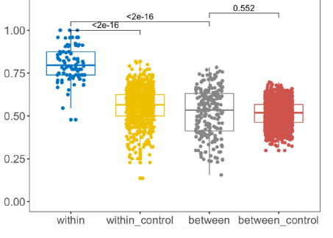
Machine learning models can be trained within but not across provinces
True Positive Rate
Penny Gordon-
Larsen
UNC Chapel Hill
Urban/Rural classification
Shan Sun
UNC Charlotte
(in press, BMC Open)

Slide 31
How do we pursue mechanism despite small effect sizes?
Go Big (increase sample size in humans)

Slide 32
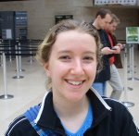

Every analysis will need to be a meta-analysis
Ivory Blakely– UNC Charlotte
Michael Sioda – UNC Charlotte

Slide 33
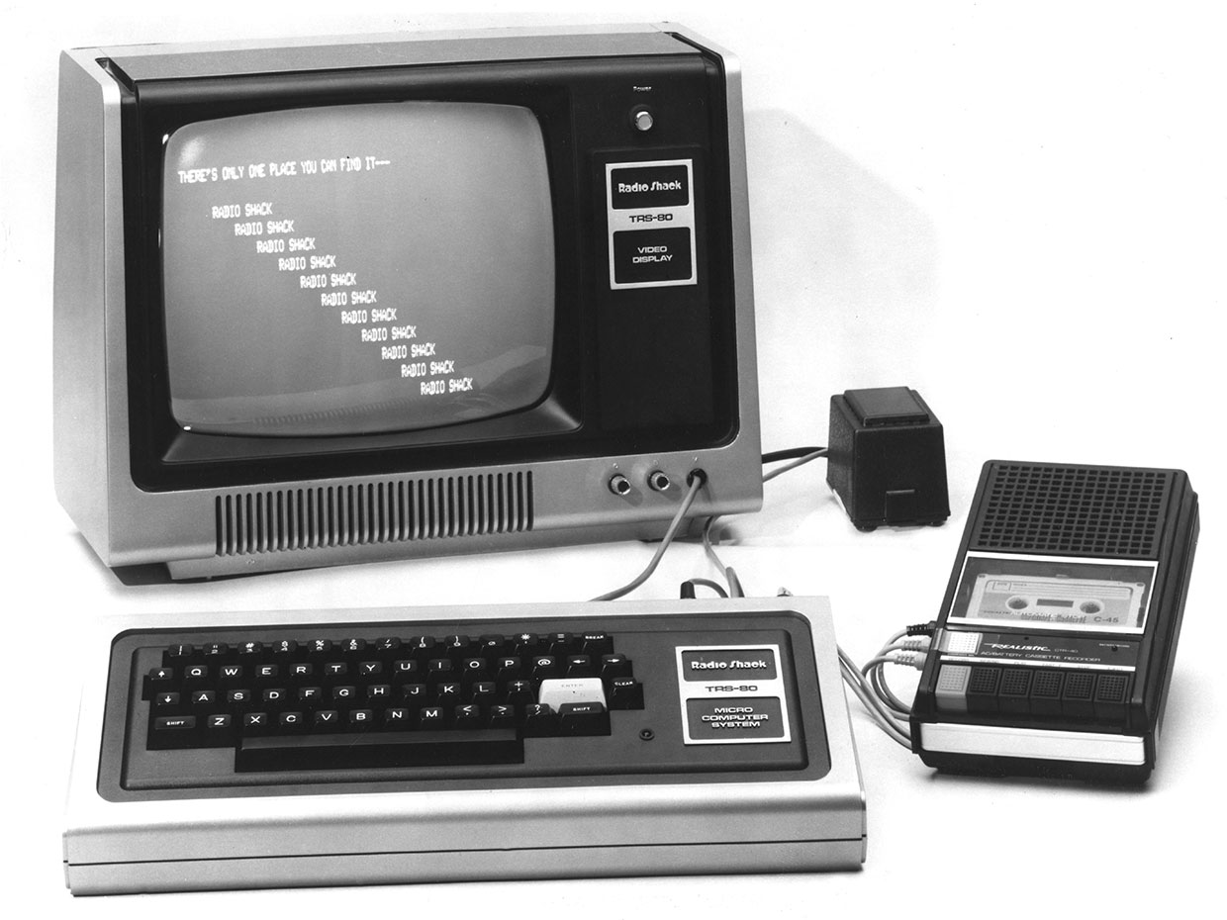
4K RAM (which I expanded 16K)
Cassette-tape storage
(30 bytes per second throughput)
128 * 48 Black and white graphics
BASIC (26 variables A-Z)
With 16K, this became 26^2 variables and
you could have arrays!
Z80 assembly language
I almost had to repeat 8th grade because of this computer
Learning to code was the key to a lot of what happened later
https://spectrum.ieee.org/consumer-electronics/gadgets/the-consumer-electronics-hall-of-fame-tandyradioshack-trs80-model-1

Slide 34
University of Washington Ph.D. – Ion Channel Biophysics
Random startups as a Java Developer in Seattle ( 2 years)
Bioinformatics analyst at Immunex/Amgen ( 2 years )
Post-doctoral associate/research fellow at Stanford (3 years)
Tenure track research position at UNC Charlotte ( 15 years)

Slide 35

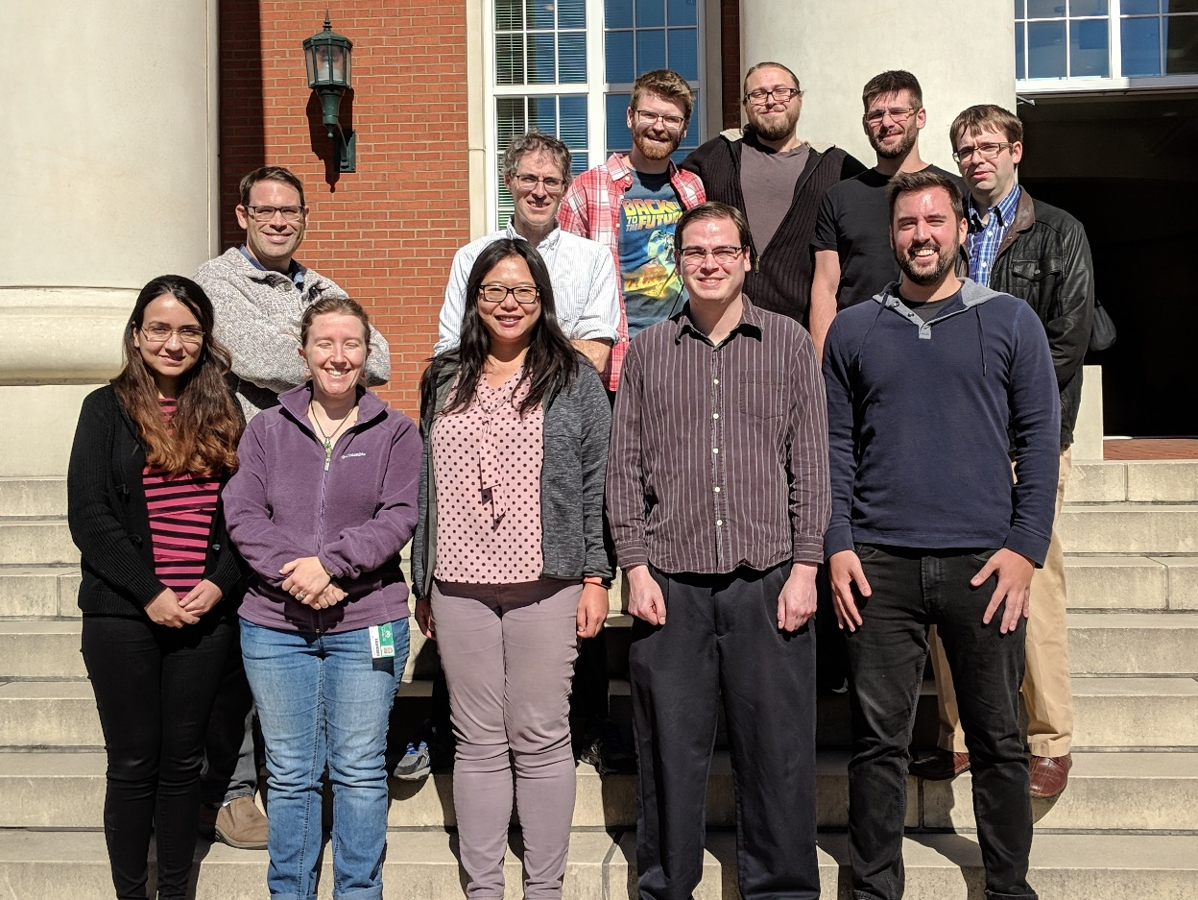

Slide 36
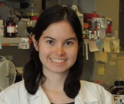


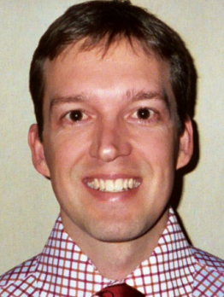

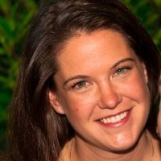


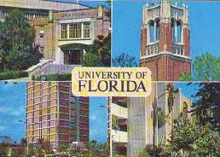



Acknowledgements
UNC-Chapel Hill
Janelle Arthur
Ian Carroll
Annie Green Howard
Marcus Muhlbauer
Penny Gordon-Larsen
Jonathan Hansen
Temitope Keku
UNC-Charlotte
Roshonda Barner
Matthew Brown
Farnaz Fouladi
Ra’ad Gharaibeh
Cynthia Gibas
Jon McCafferty
Shan Sun
Michael Sioda
Kathryn Winglee
Matthew Brown
UF- Gainesville
Christian Jobin
USC Vanderbilt University
Tanya L Alderete Martha J. Shrubsole
Michael Goran
Emily Noble
Scott Kanoski
Kathryn Winglee
Annie Green Howard
Penny Gordon-Larsen
Raad Gharaibeh
Jon McCafferty
Marcus Muhlbauer
Janelle Arthur
Christian Jobin

Slide 38
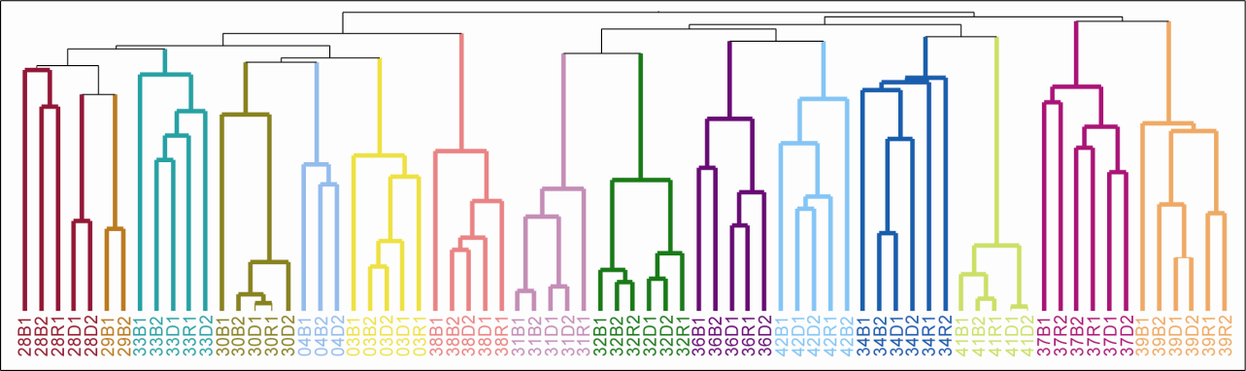
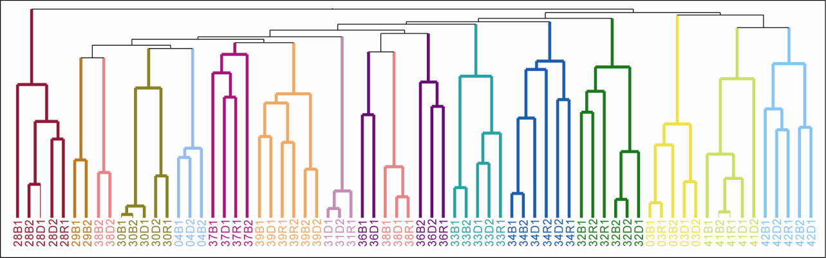


Human gut microbial communities are distinctly individual
Individuality persists despite common diet and conditions
OTUs at 97%
ARISA
Melanie Spencer
Atrium Health
Steve Zeisel UNC
Melanie D. Spencer, Timothy J. Hamp, Robert W. Reid, Leslie M. Fischer, Steven H. Zeisel, Anthony A. Fodor. Gastroenterology. 2011

Slide 39
Effect Sizes in Association Studies are Reliably Small
There is strong individual variation in the microbiome
Sample sizes need to be very large
Inference can survive technical differences

Slide 40
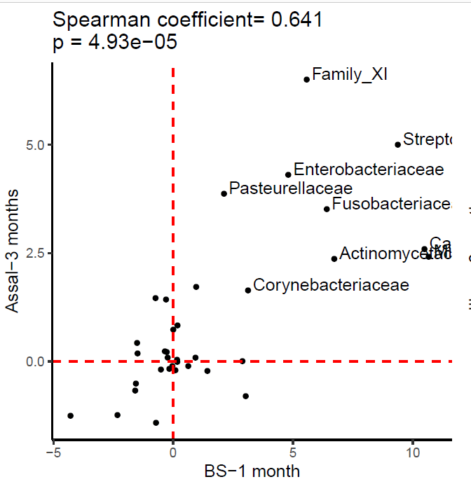

It is possible to get reproducible results across studies from different labs
Farnaz Fouladi
UNC Charlotte

Slide 41
Experimental design
Visualization and statistical analysis
Sample Size (# of cages not just # of mice)
Properly consented cohorts
Capture of confounding variables
Sufficient variation across space and time
Negative and Positive controls
Which diversity metrics?
Log-transform data?
Parametric or non-parametric tests?
Simple linear models?
Mixed models?
Zero-inflated models?
Negative-binomial based models?
Correction for multiple hypothesis testing?
Remove rare taxa?
Track sequencing depth as a confounder.
Track potential biological confounders
(e.g. cage in mouse experiments; drugs in
human surveys)
Supervised classification to build predictive
models? Cross-fold validation?
Random Forest classifiers?
Reproducibility across cohorts and datasets
generated by different labs?
Ordination?
Unifrac (weighted or un-weighted).
or PcOA? With what distance metric
(Bray-Curtis?)
Multi-page, multi-factorial visualizations?
DNA extraction
Which extraction kit/protocol?
Which sequencing platform?
Whole genome or 16S? If 16S, which primers?
sequencing
Merged paired ends? With what parameters?
Qual score filter? With what parameters?
Filter against database of known sequences? With what parameters?
Chimera check? Which algorithm? With what parameters?
Sufficient sequencing depth? Remove unique sequences?
Classification/clustering
Reference database or denovo OTUs? Or something in between?
Which algorithm (RDP, kraken, greengenes, uparse)?
What database? With what parameters?
Are the sequences microbial? From the expected tissue?
Are they just kit microbes?
Normalization
Simple proportions? Rarefication (with what depth?
single rarefication vs. average).
Balance trees? Ratio space? Geometric Mean based normalization?

